Slide 1
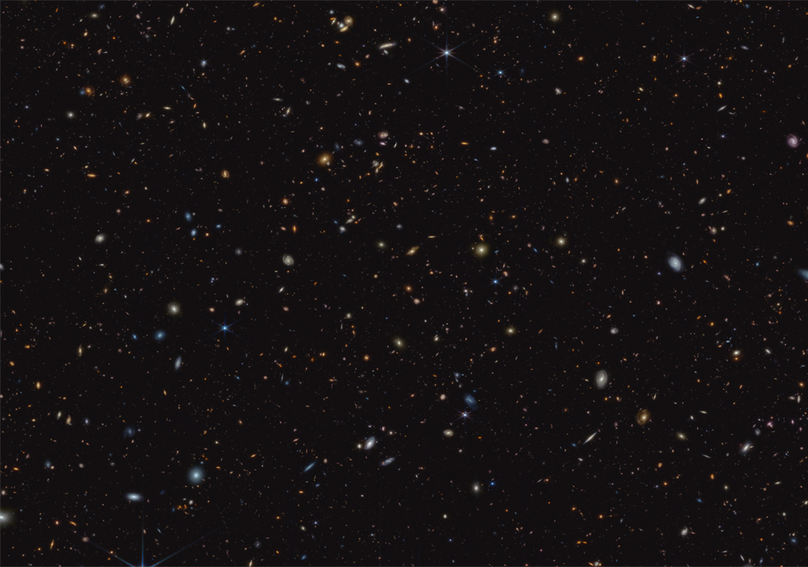
Modeling a M*~ 10¹¹ M☉ galaxy at z ~ 1.55 detected with JWST/MIRI
CHRIST COSPAR 2025
Shankar Ray, PhD Student, CHRIST (Deemed to be University)
Project Supervisor: Stacey Alberts, University of Arizona/ Space Telescope Science Institute (STScI)

Slide 2
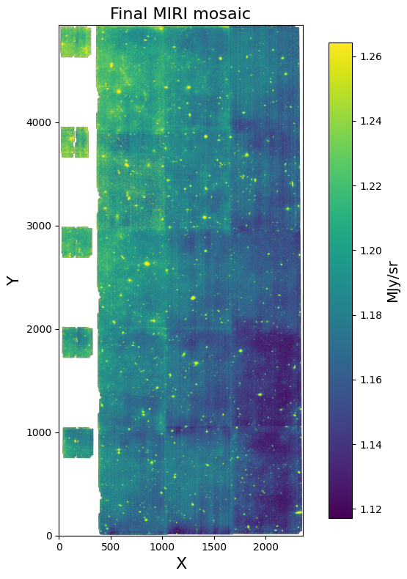
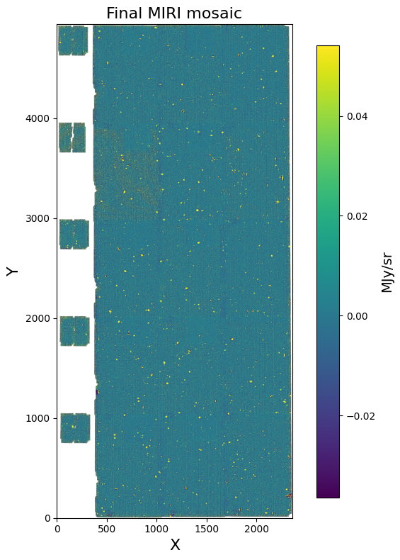
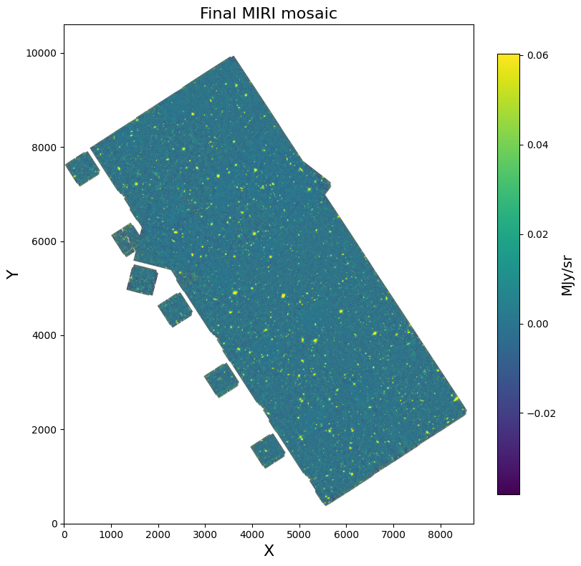
MIRI F560W data calibration from SMILES survey (Alberts et al. 2024, Rieke et al. 2024)
Pipeline product after ‘modified’ background estimation and subtraction (intervention needed just before stage 3 of the pipeline)
Default pipeline product
HLSP for F560W

Slide 3
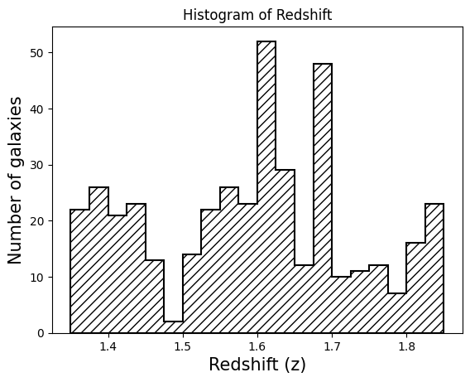
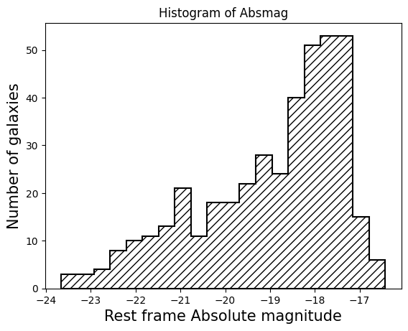
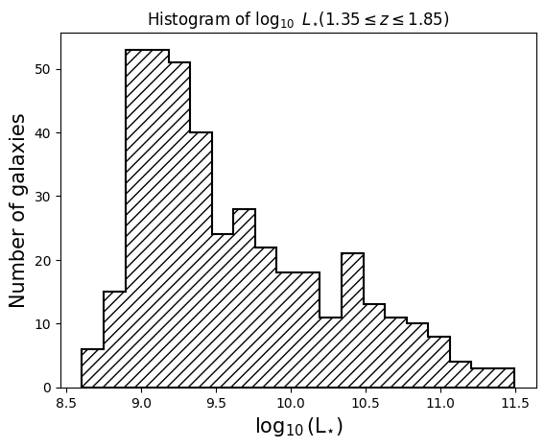
Few properties of galaxies within 1.35 ≲ z ≲ 1.85 with F560W
Here, we show some histograms of the galaxies found in the redshift range of 1.35 to 1.85 for which the 2MASS Ks ~2.2 micron emission is observed in F560W. We found a total of 412 galaxies in this redshift range.

Slide 4
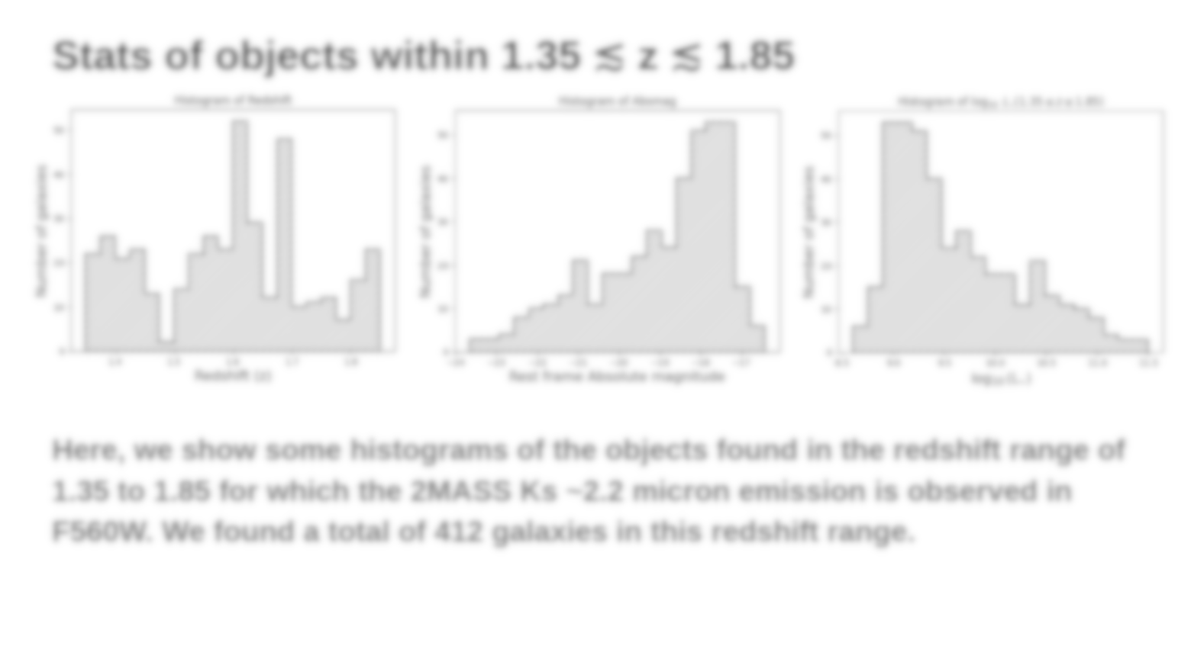
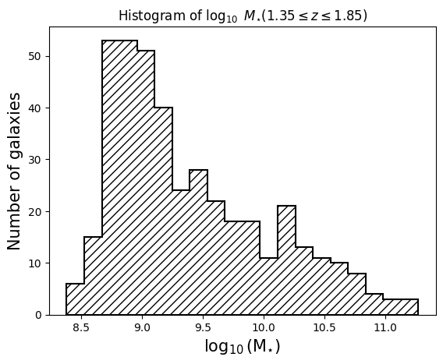
The galaxy I have modeled is right here!

Slide 5
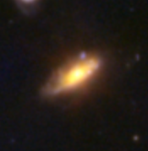
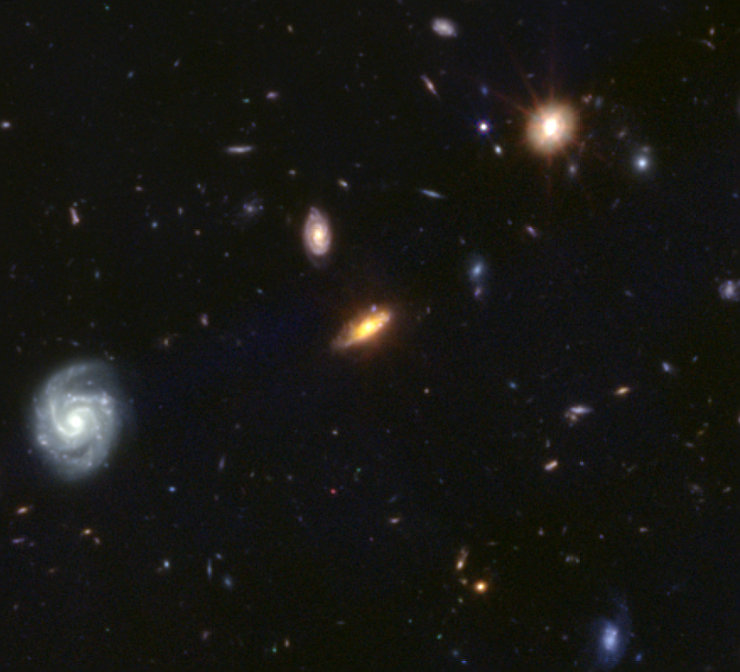
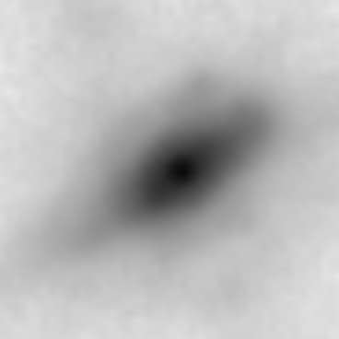
How does that massive galaxy look like?
F560W
RGB Image (Credit: The Dawn JWST Archive)
RA, DEC = 53.17, -27.77
F560W image is taken as an input for structural decomposition after masking for background sources (stars and/or galaxies)

Slide 6
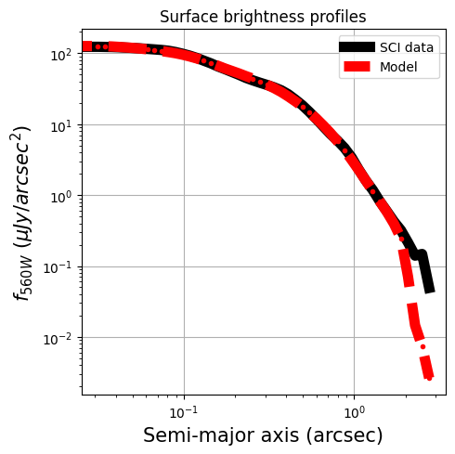
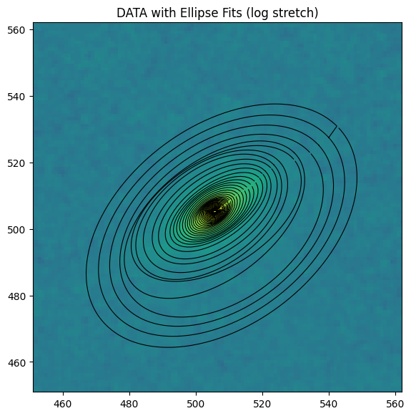
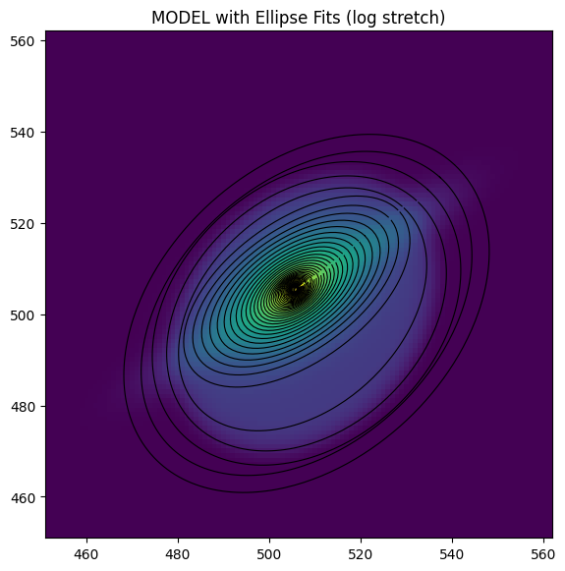
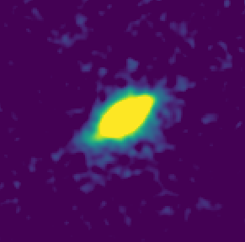
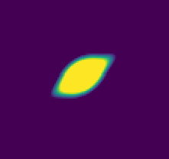
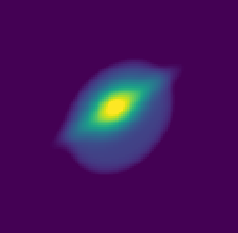
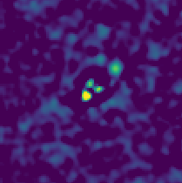
Decomposing the structure of the massive galaxy
What did we do? The galaxy is modeled by two Sersic, one exponential and a point spread function using GALFIT (Peng et al. 2010).
What did we get?
Sersic 1 effective radius (r_{e}) as ~ 5.8 kpc and sersic index (n) ~0.89,
Exp-disk effective radius (r_{e}) as 3.2 kpc,
Sersic 2 is much fainter with effective radius (r_{e}) ~ 11.4 kpc and sersic index (n) ~ 0.1.
This galaxy does not have any bulge (or maybe has a pseudo bulge!).
The PA of Sersic 2 (-40 deg) is different from Sersic 1 (-58 deg) and Exp-disk profile (-52 deg). It introduces a slight distortion in the model. We need to further investigate whether there is an actual asymmetry in the disk of the galaxy or the function needs to be constrained further for better results.
Ellipse fit in data
Ellipse fit in model
Data
Model
Model
Residual

Slide 7
Thank you!

